Slide 1
CreatIng Darwin Core Archives
USING THE
IPT

Slide 2
What is a Darwin Core Archive?
Essentially a standardized set of files that rely on the Darwin Core Namespace
Most files relate to each other in a manner similar to tables in a relational database
Also contains a metadata file that describes the package

Slide 3
What is the Integrated Publishing Toolkit (IPT)?
The IPT is a tool that is used to crosswalk or map data into the form of a Darwin Core Archive
The IPT then sends the data package over to GBIF, where it is made available for download
Each dataset gets its own “profile” page where the Ecological Metadata File (eml.xml) is displayed in a human readable format
https://www.gbif.org/dataset/7a25f7aa-03fb-4322-aaeb-66719e1a9527

Slide 4
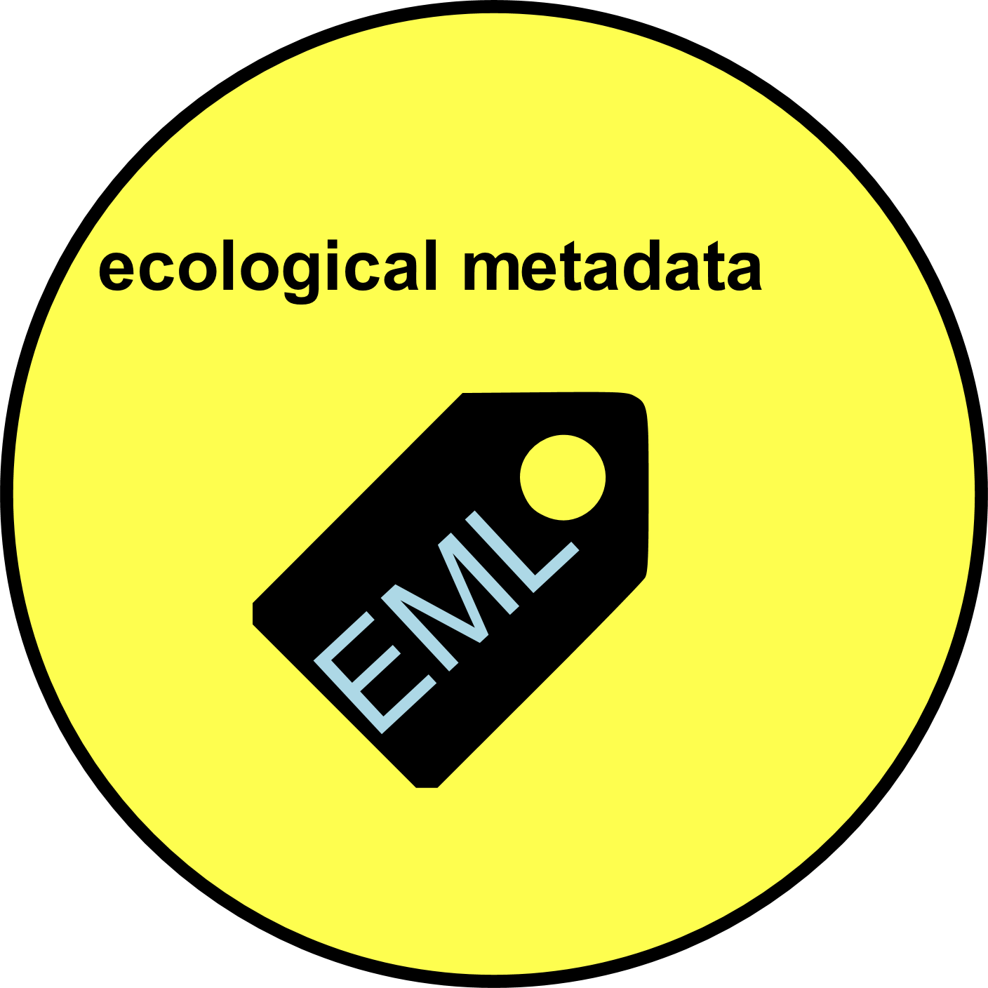


Slide 5
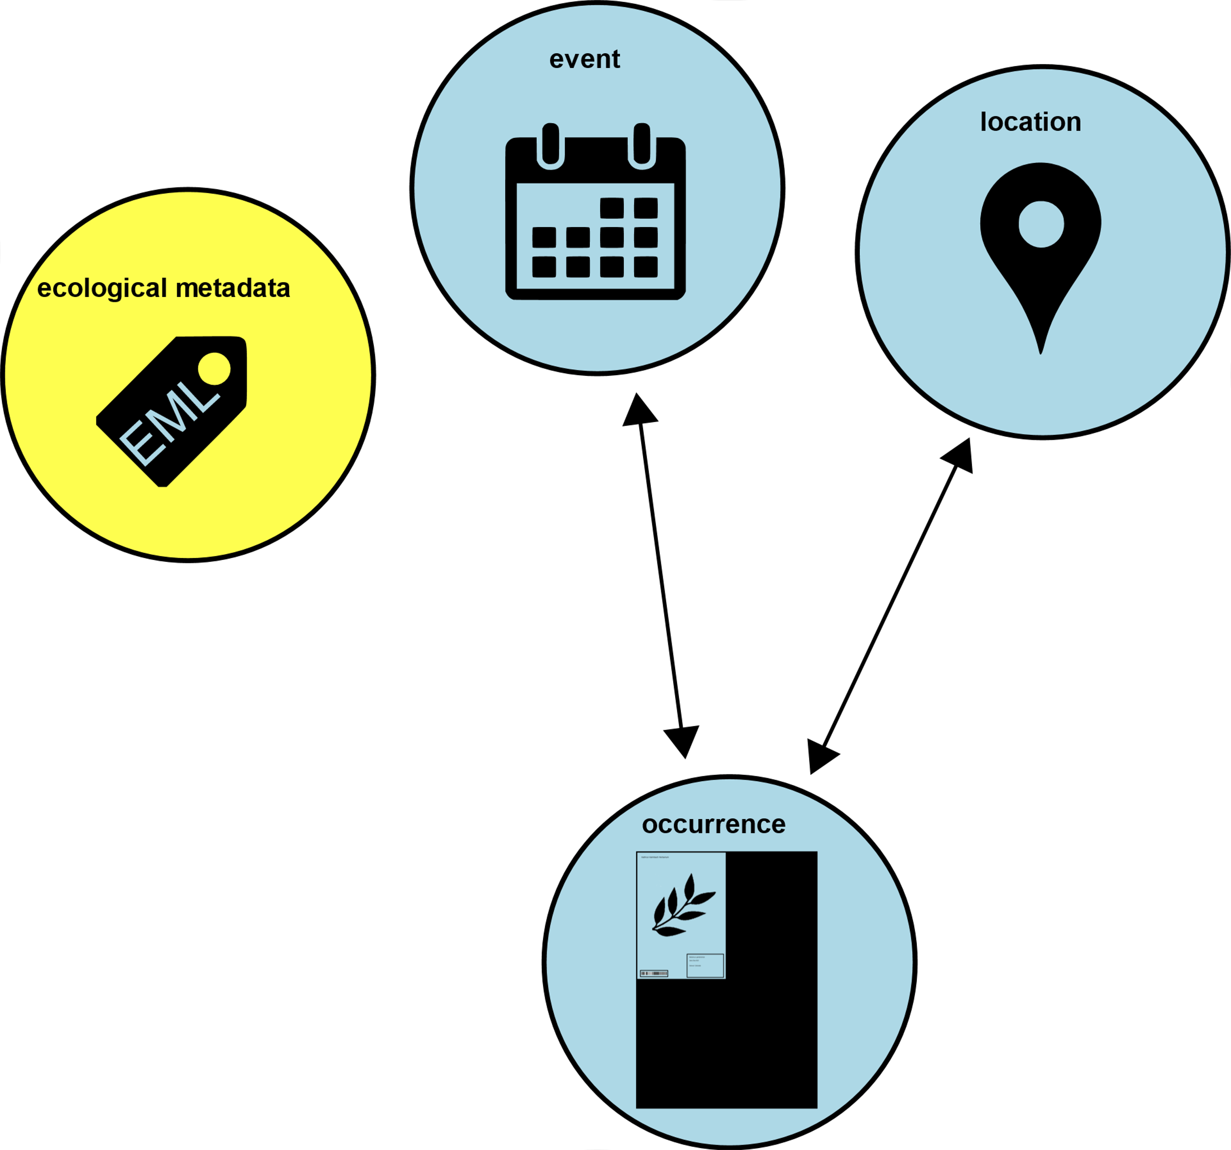

Slide 6
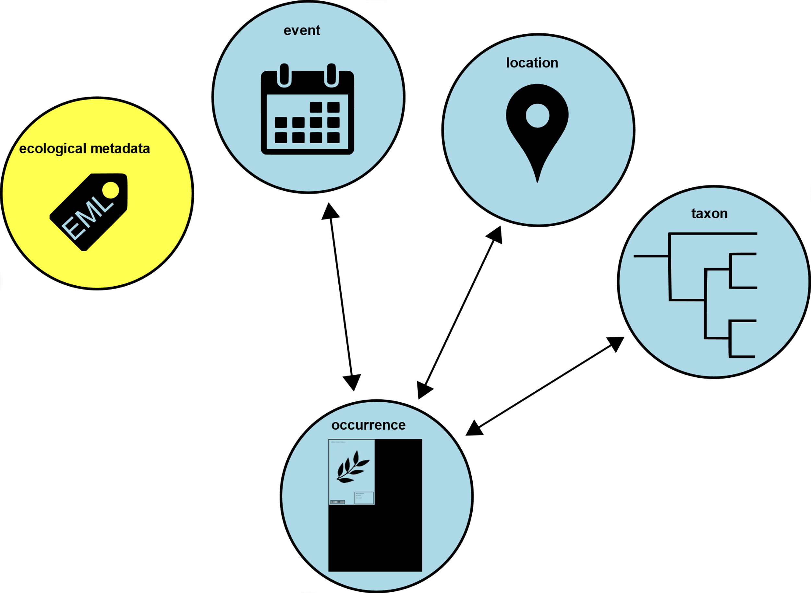

Slide 7
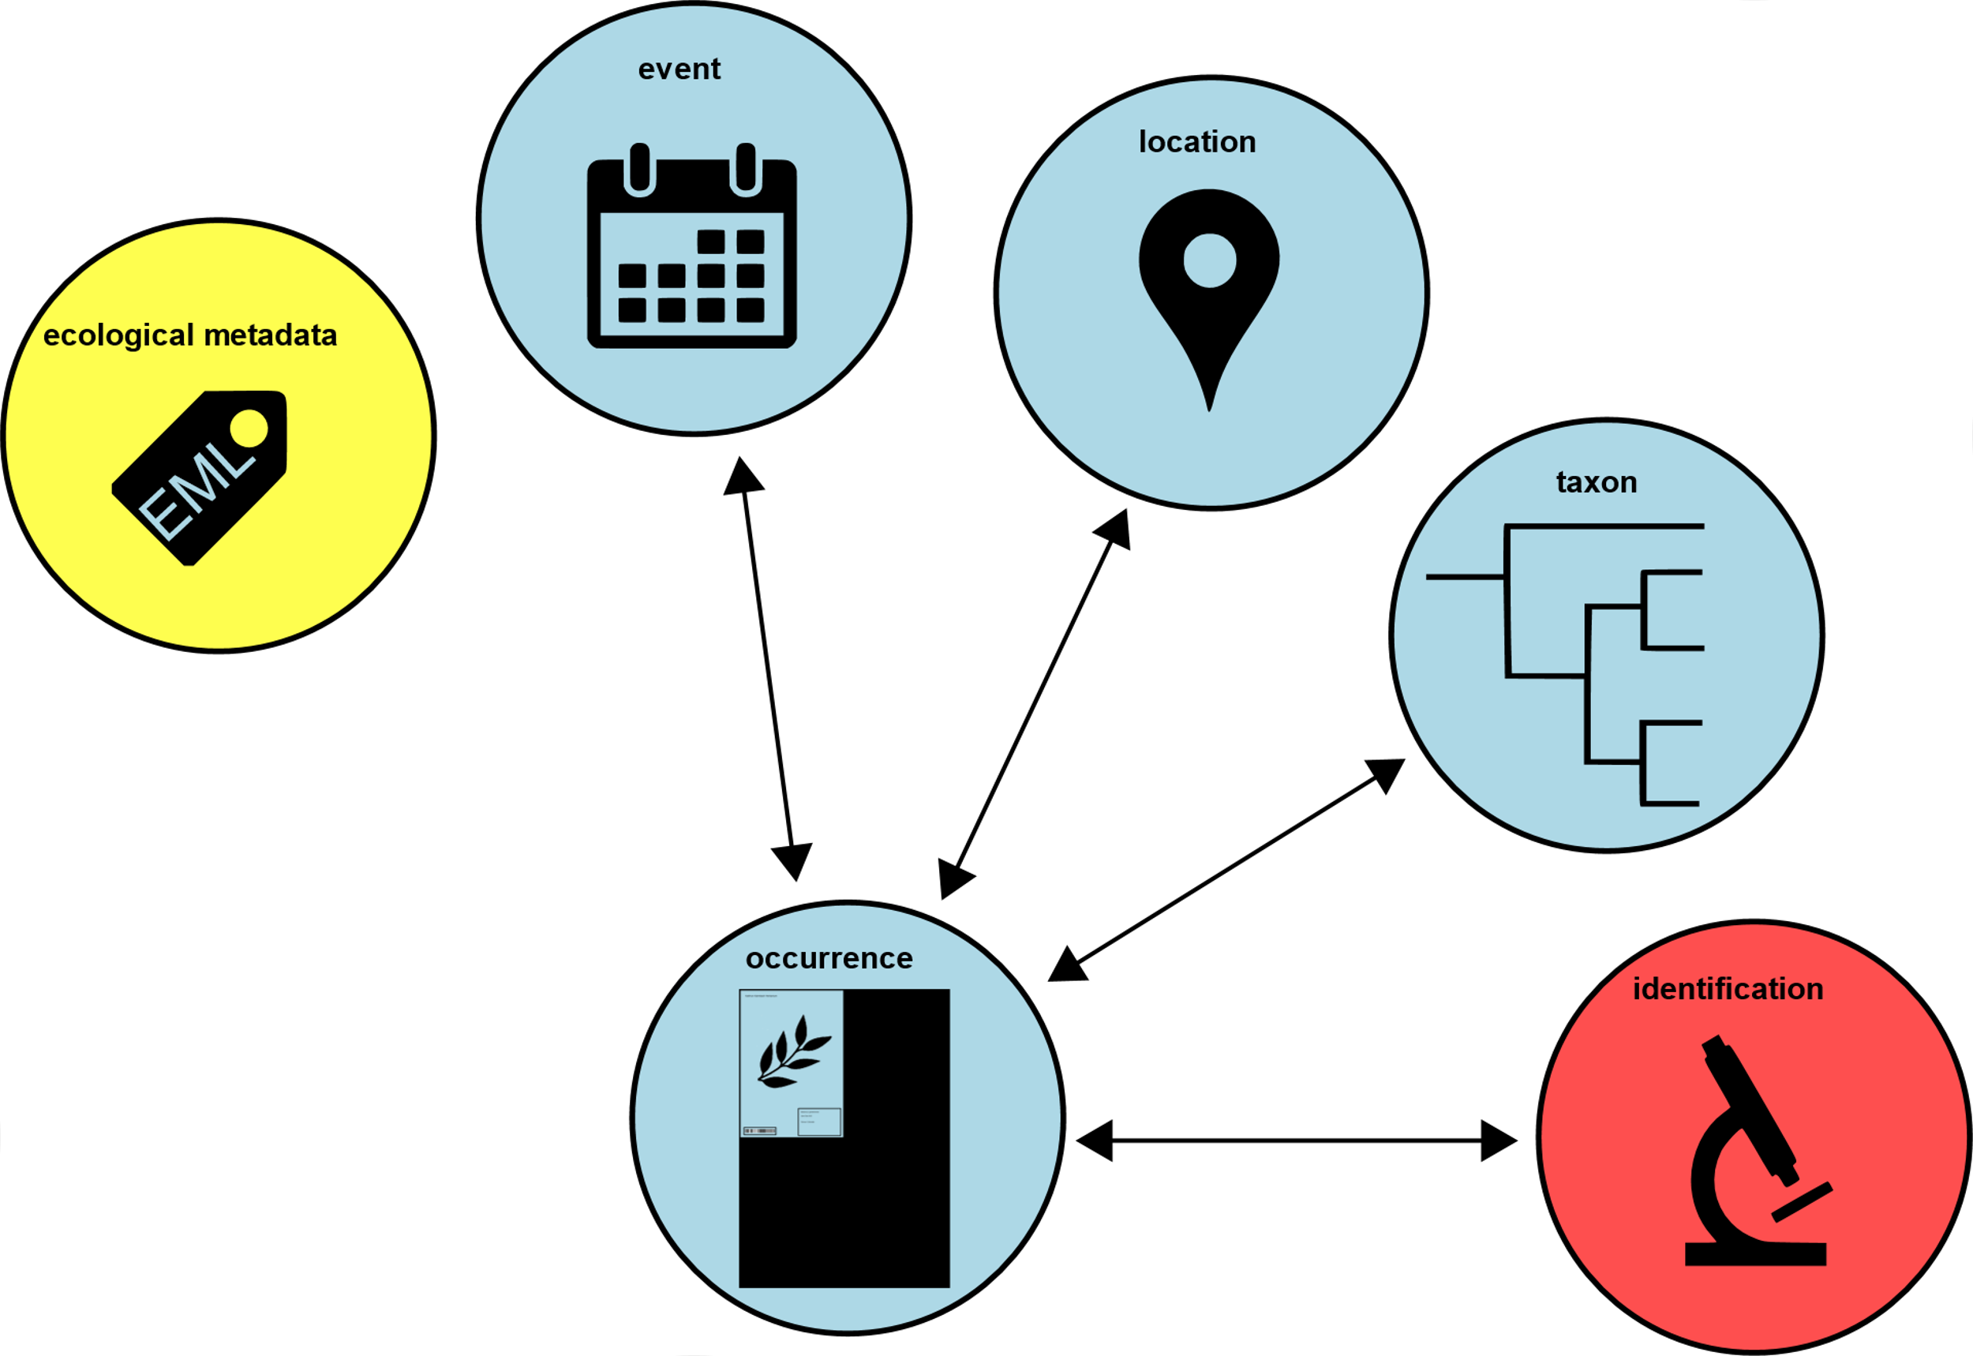

Slide 8
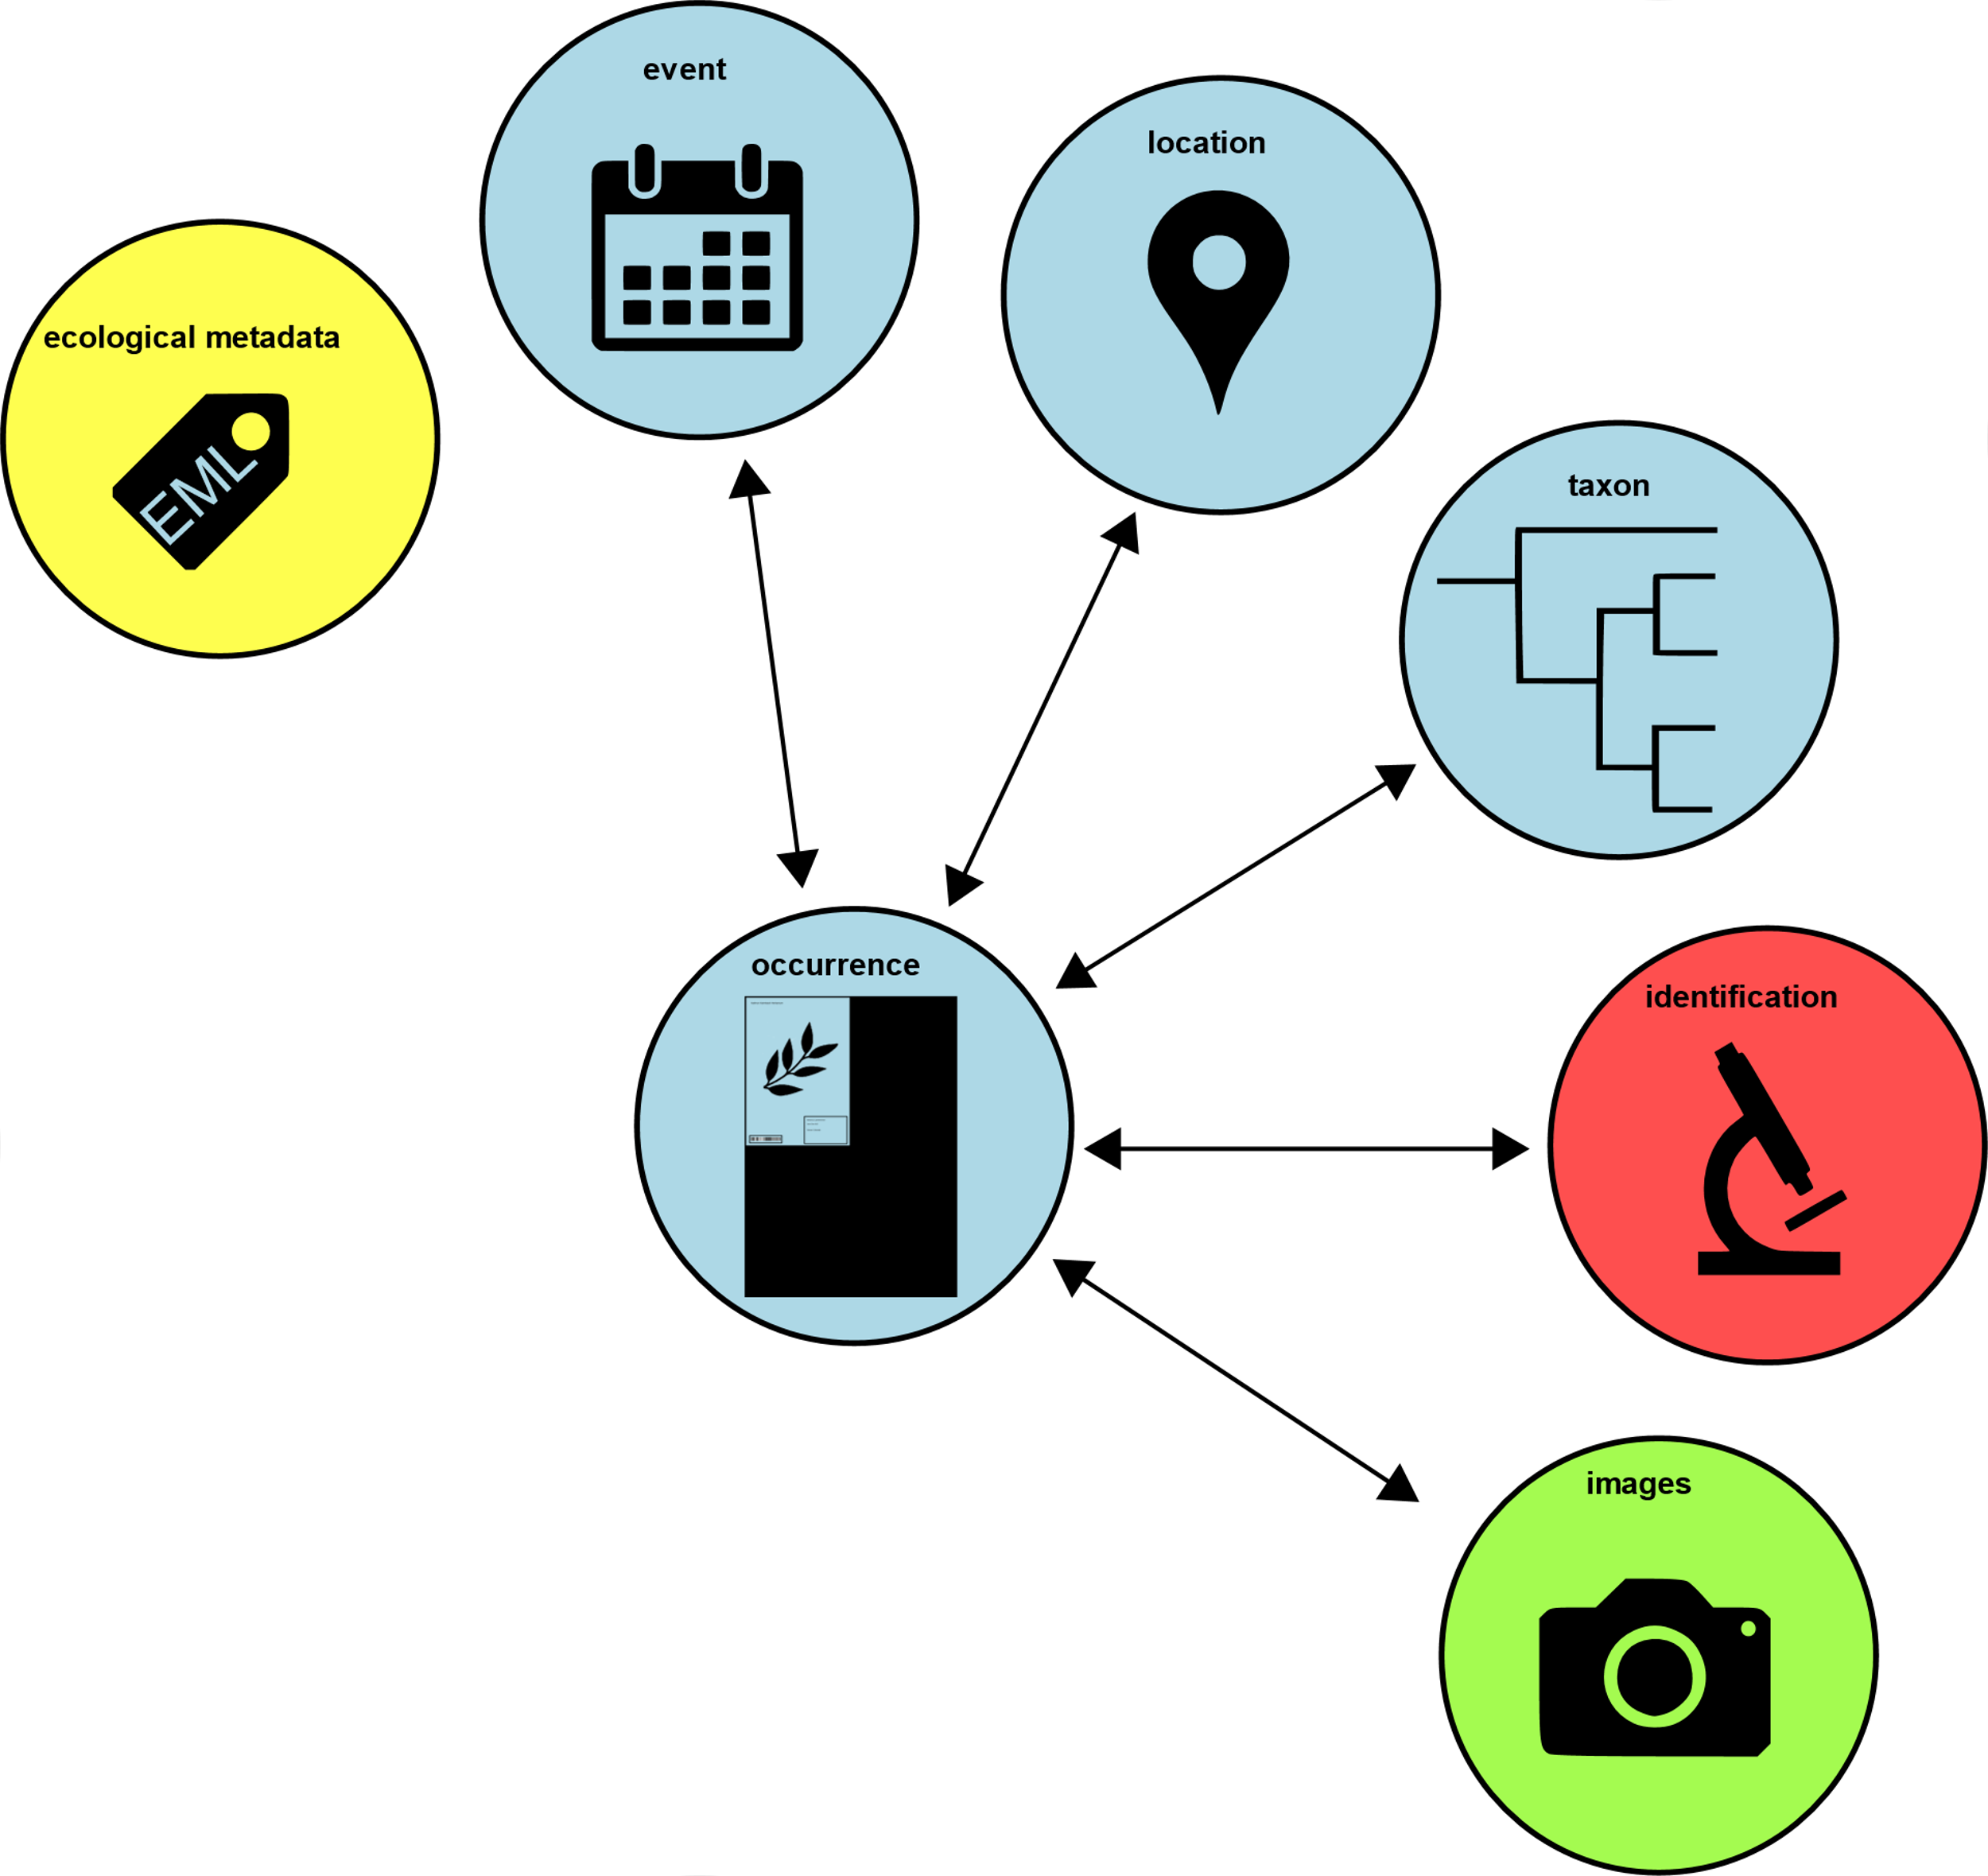

Slide 9
Extensions
Extensions to the Darwin Core allow for more types of data to be included within DwC Archive
Extensions are proposed, tested and eventually may be registered with GBIF
https://tools.gbif.org/dwca-validator/extensions.do

Slide 10
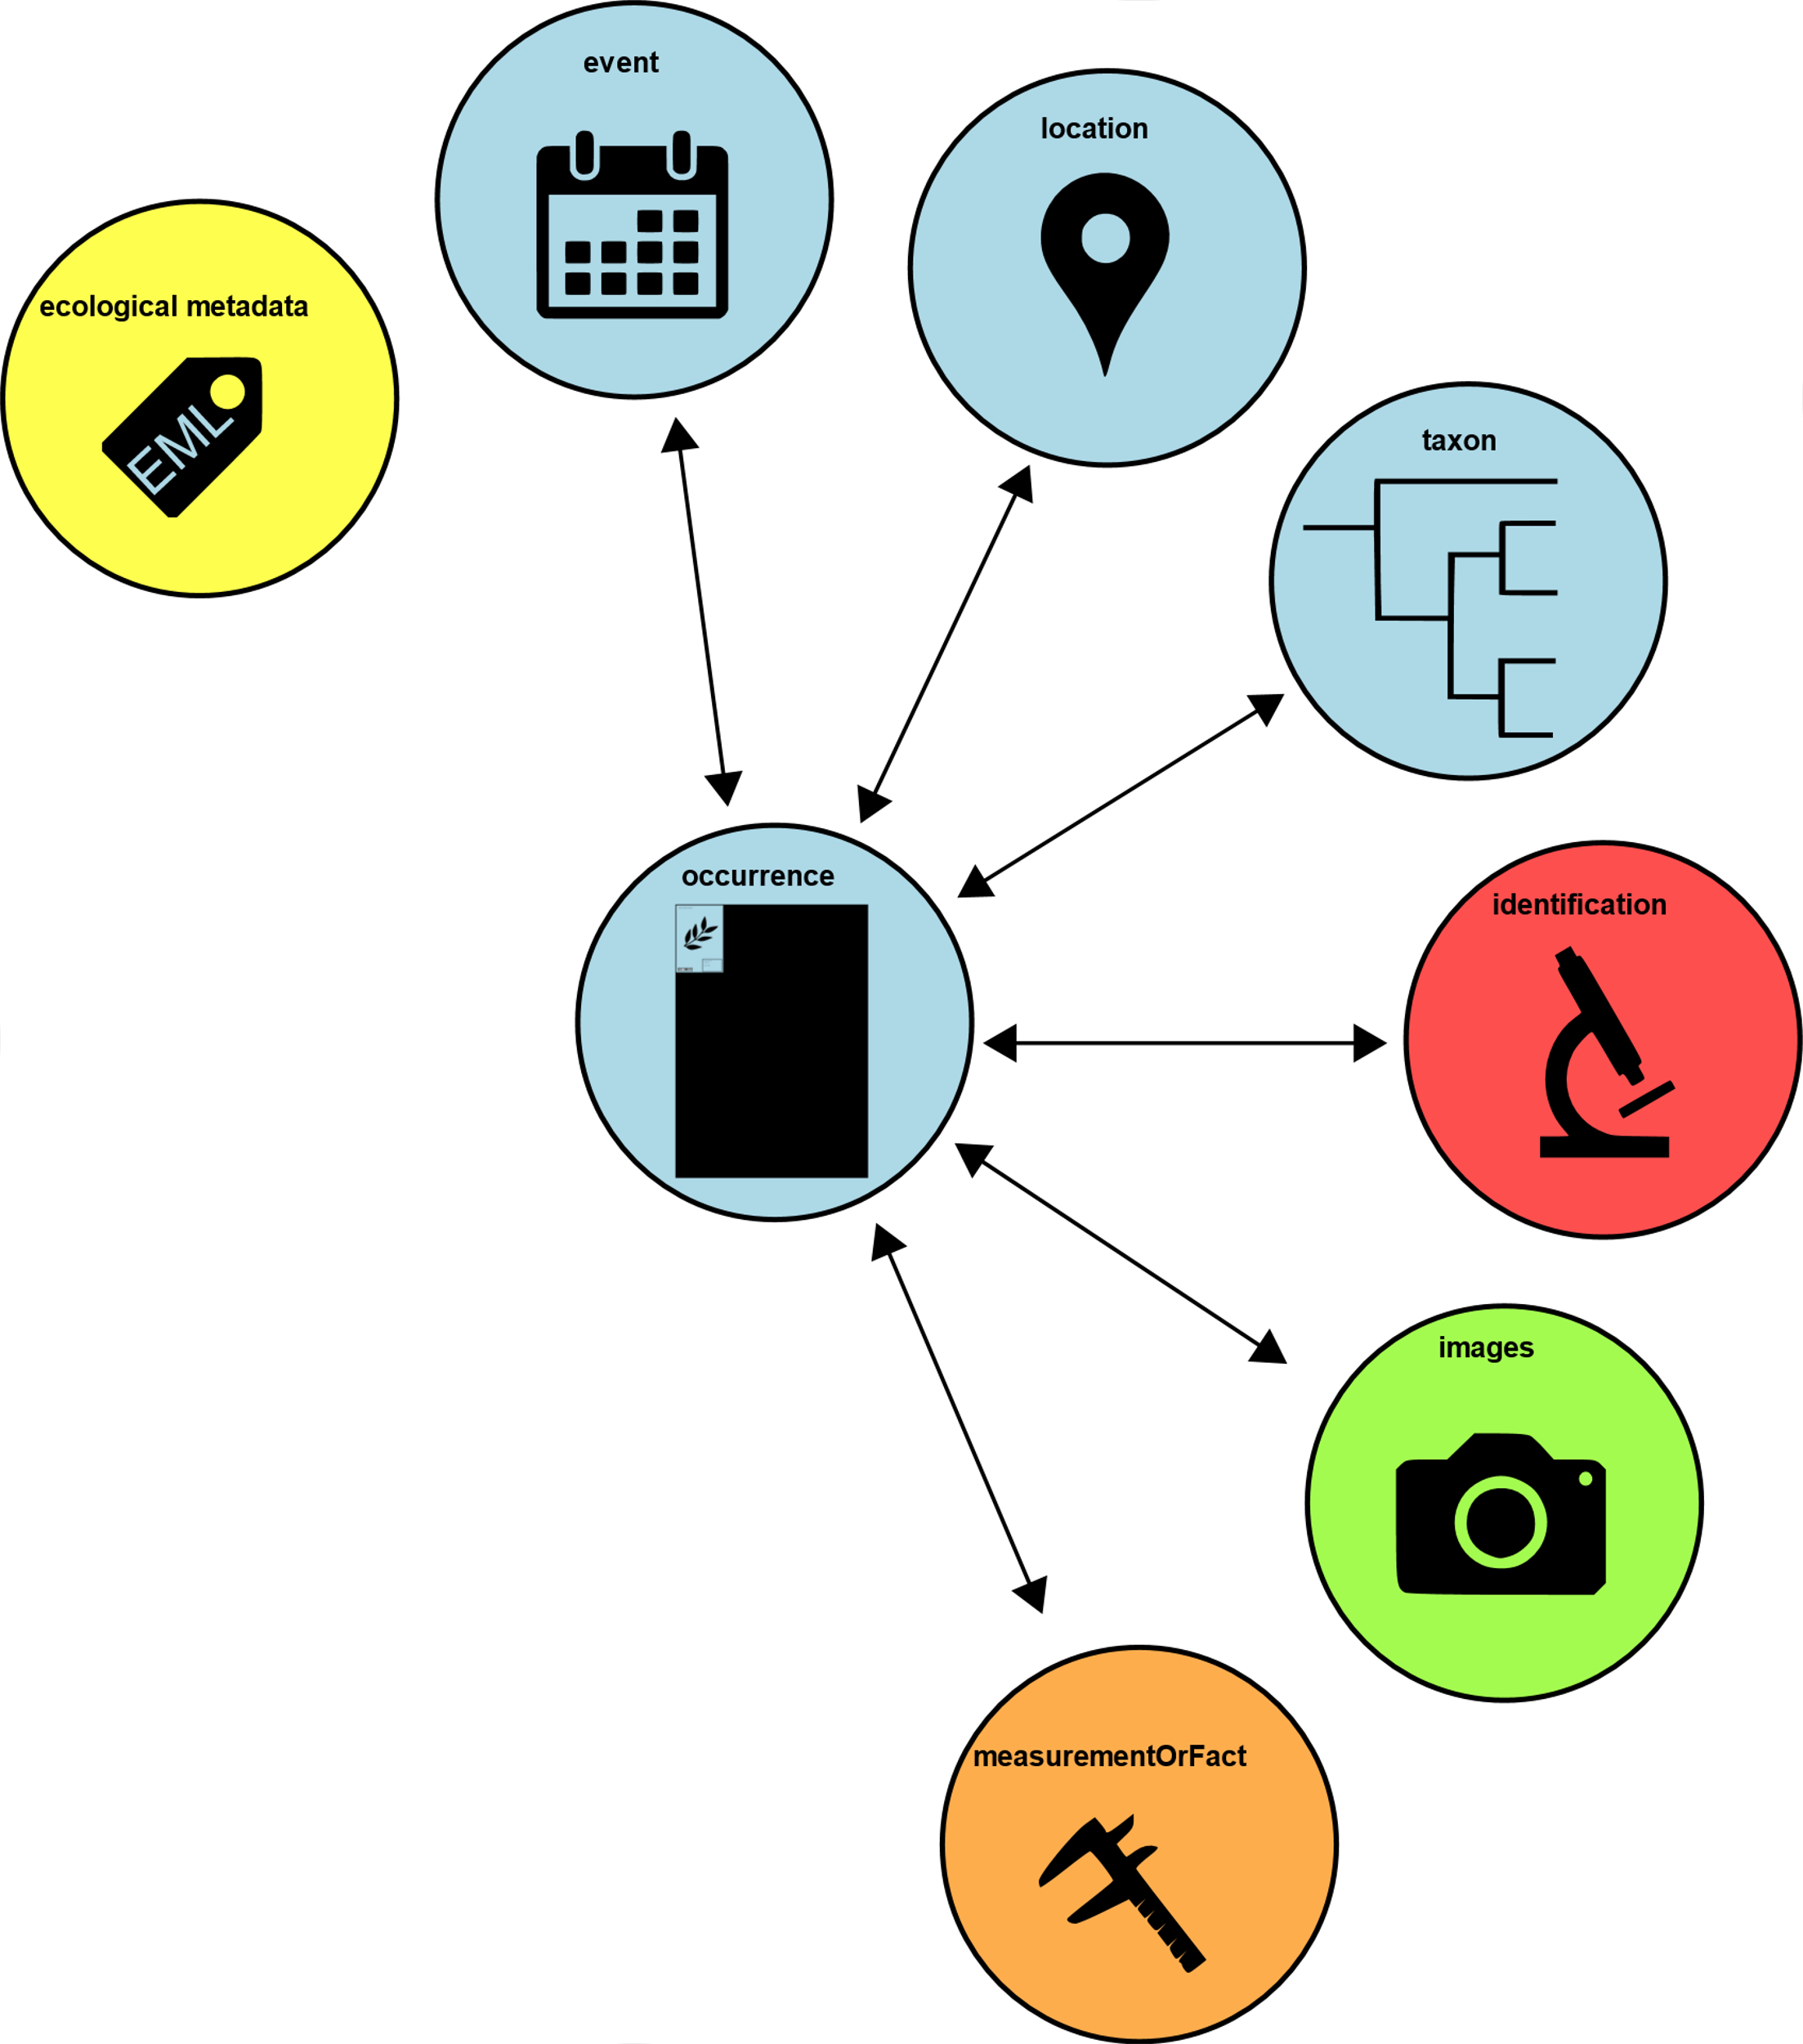
https://tools.gbif.org/dwca-validator/extension.do?id=dwc:MeasurementOrFact
Measurement Or Fact Extension

Slide 11
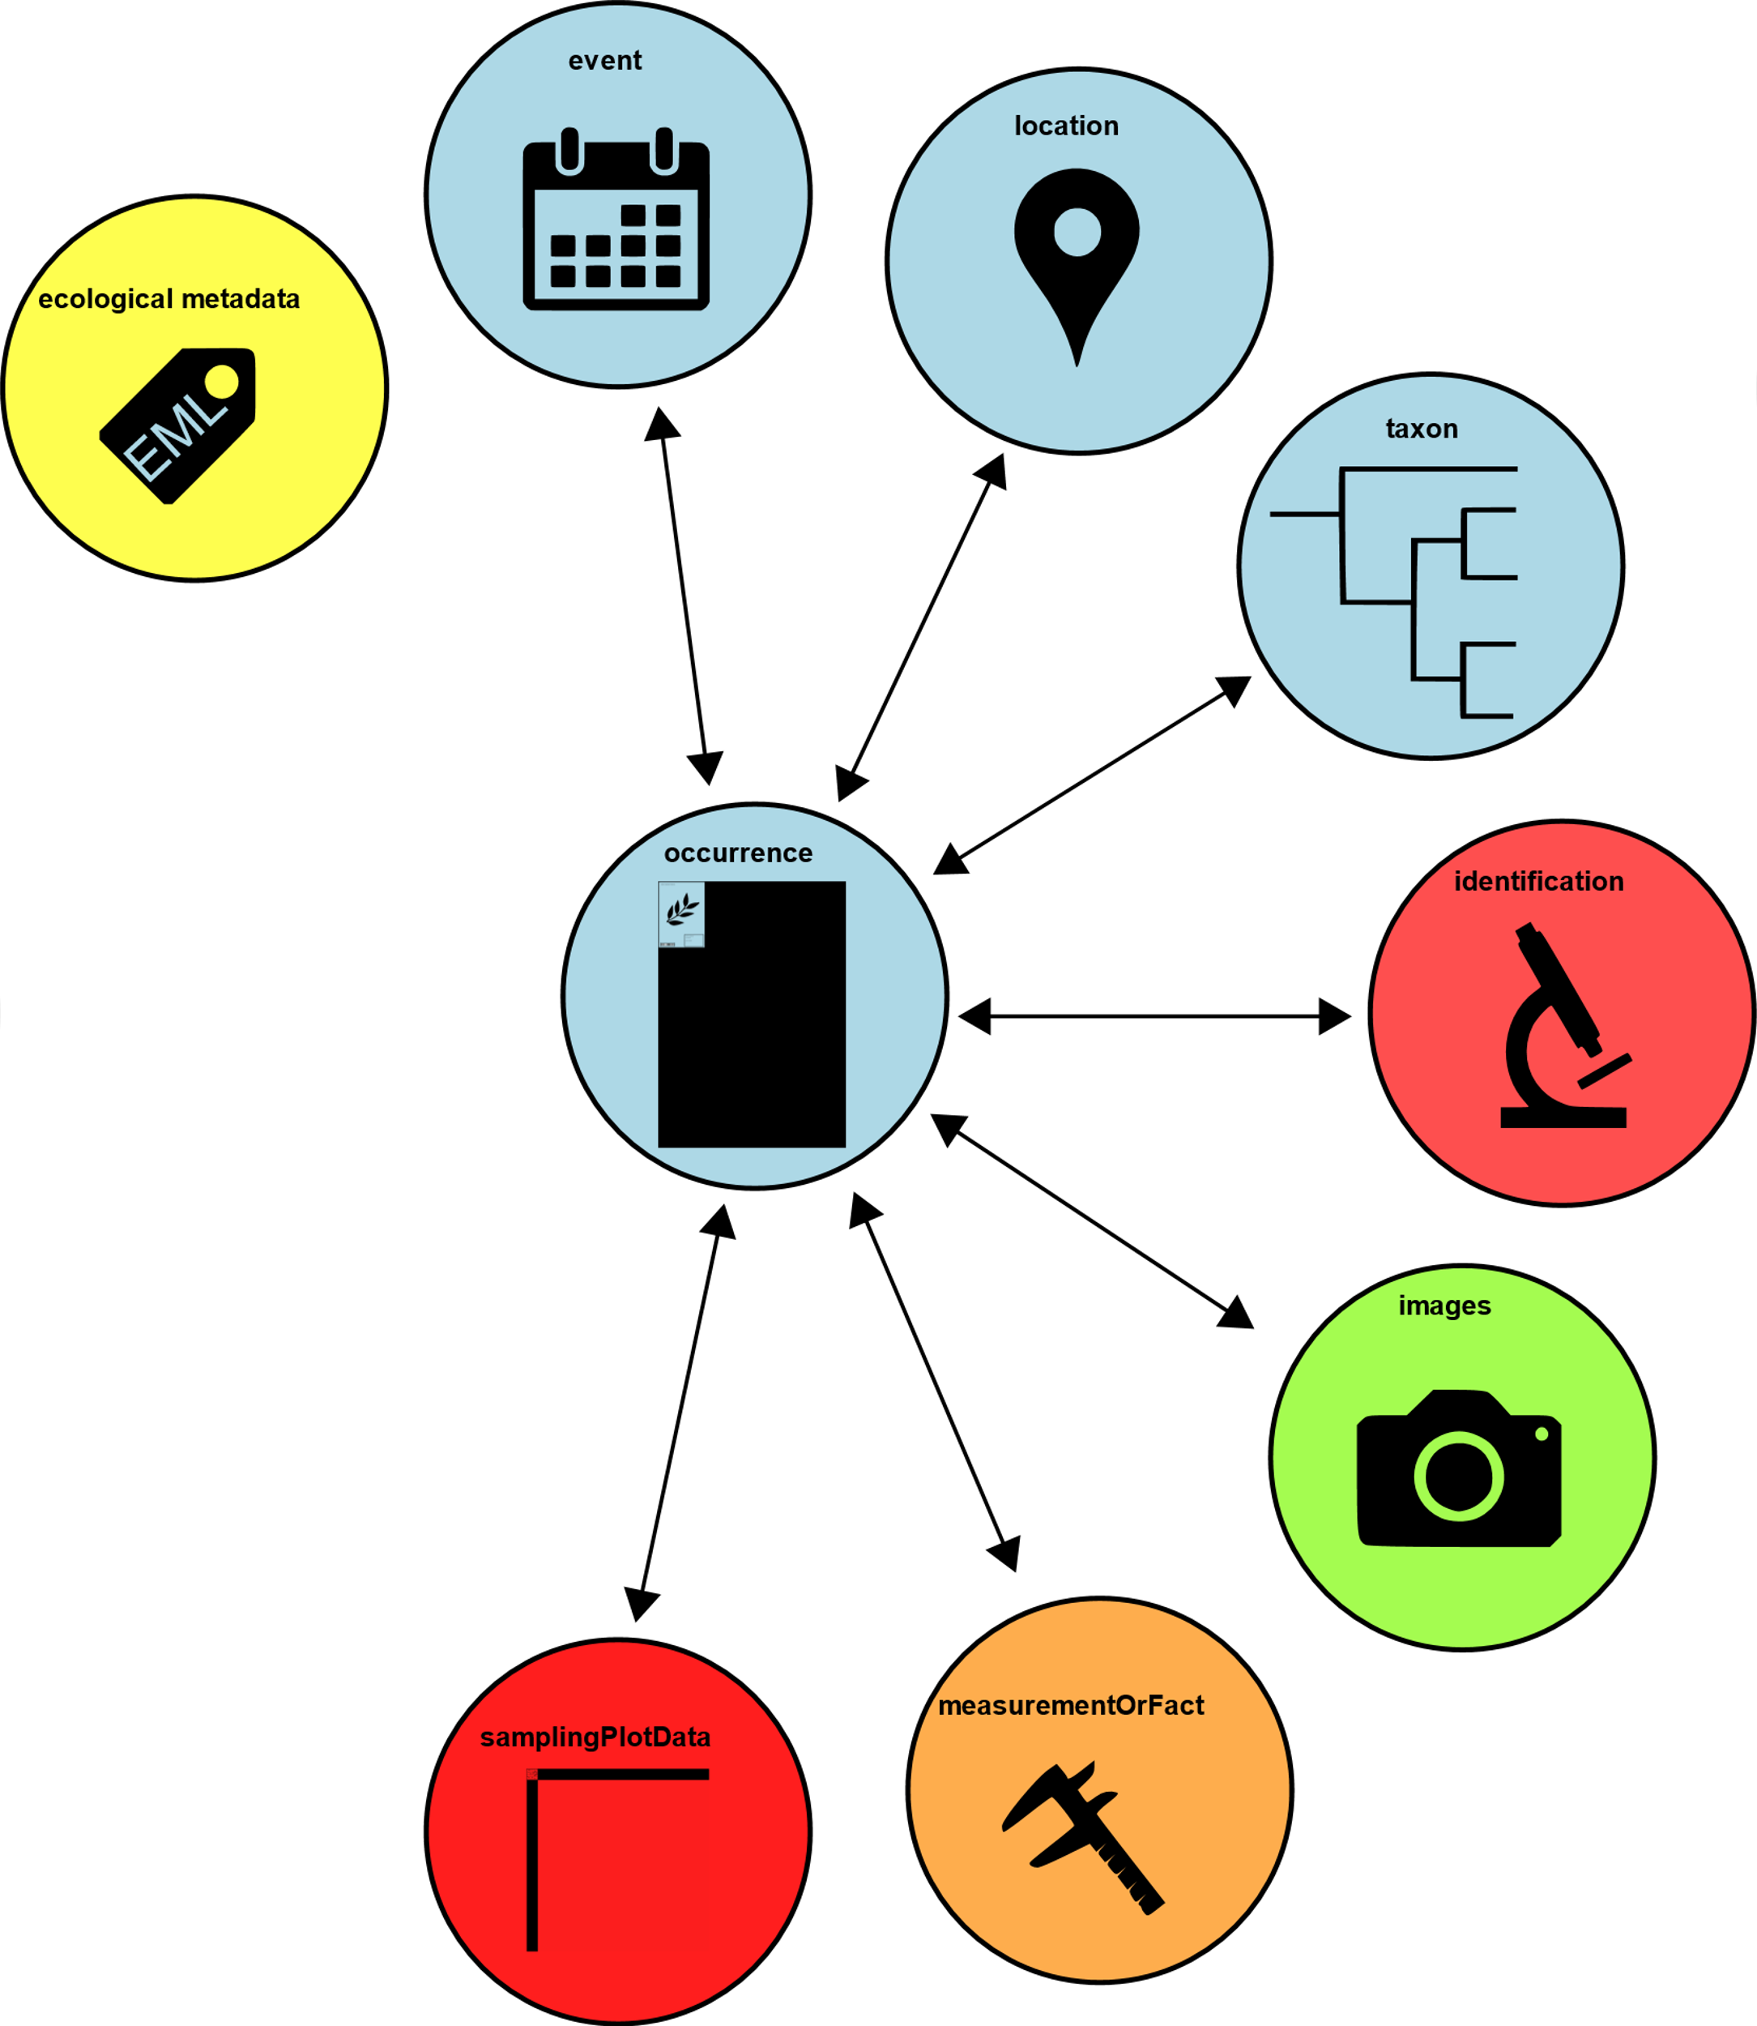
Relevé Extension
(vegetation plot data)

Slide 12
Special Interest Extensions
Global Genome Biodiversity Network (GGBN) http://data.ggbn.org/ggbn_portal/
Essentially a library of tissue and DNA samples, that researchers can borrow
Part of Global Genome Initiative (GGI) https://ggi.si.edu/
GGBN needs extensions specific to the data types they find useful
https://tools.gbif.org/dwca-validator/extensions.do

Slide 13
